Slide 1

How did OSU Football Games Impact Public Transit?
Luyu Liu
Department of Geography
The Ohio State University
liu.6544@osu.edu
2022/10/8

Slide 2
Public Transit and How Good are They?
How far you can go from Columbus downtown in the real world (orange) versus in the schedule (blue) with different time budgets
Accessibility: how far you can go?
Unreliability: how different is your experienced accessibility from the scheduled one?
These two factors measure how good the system perform
They can be influenced by different disruptions

Slide 3
OSU Football Games
Short-term disruption: Ohio State Football Game 2018 – 2019
Create massive traffic around Ohio Stadium
Last about few hours
Do not significantly change the schedule

Slide 4
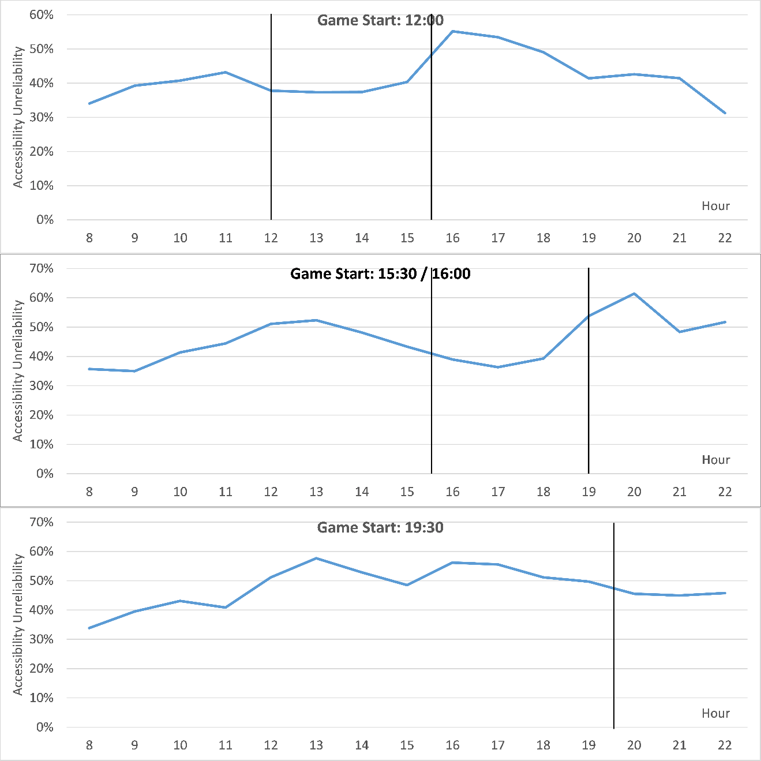
Football: Temporal Pattern
Average hourly profile of unreliability on all 13 OSU football game days
Black lines indicates start and end of each game
Two peaks before and after the game and move with the game start time

Slide 5
Football: Temporal Pattern
Unreliability:
home game days > away game days > non-game days
Consistency:
for all 13 game days, before-game and after-game unreliability peaks always move with the game time

Slide 6
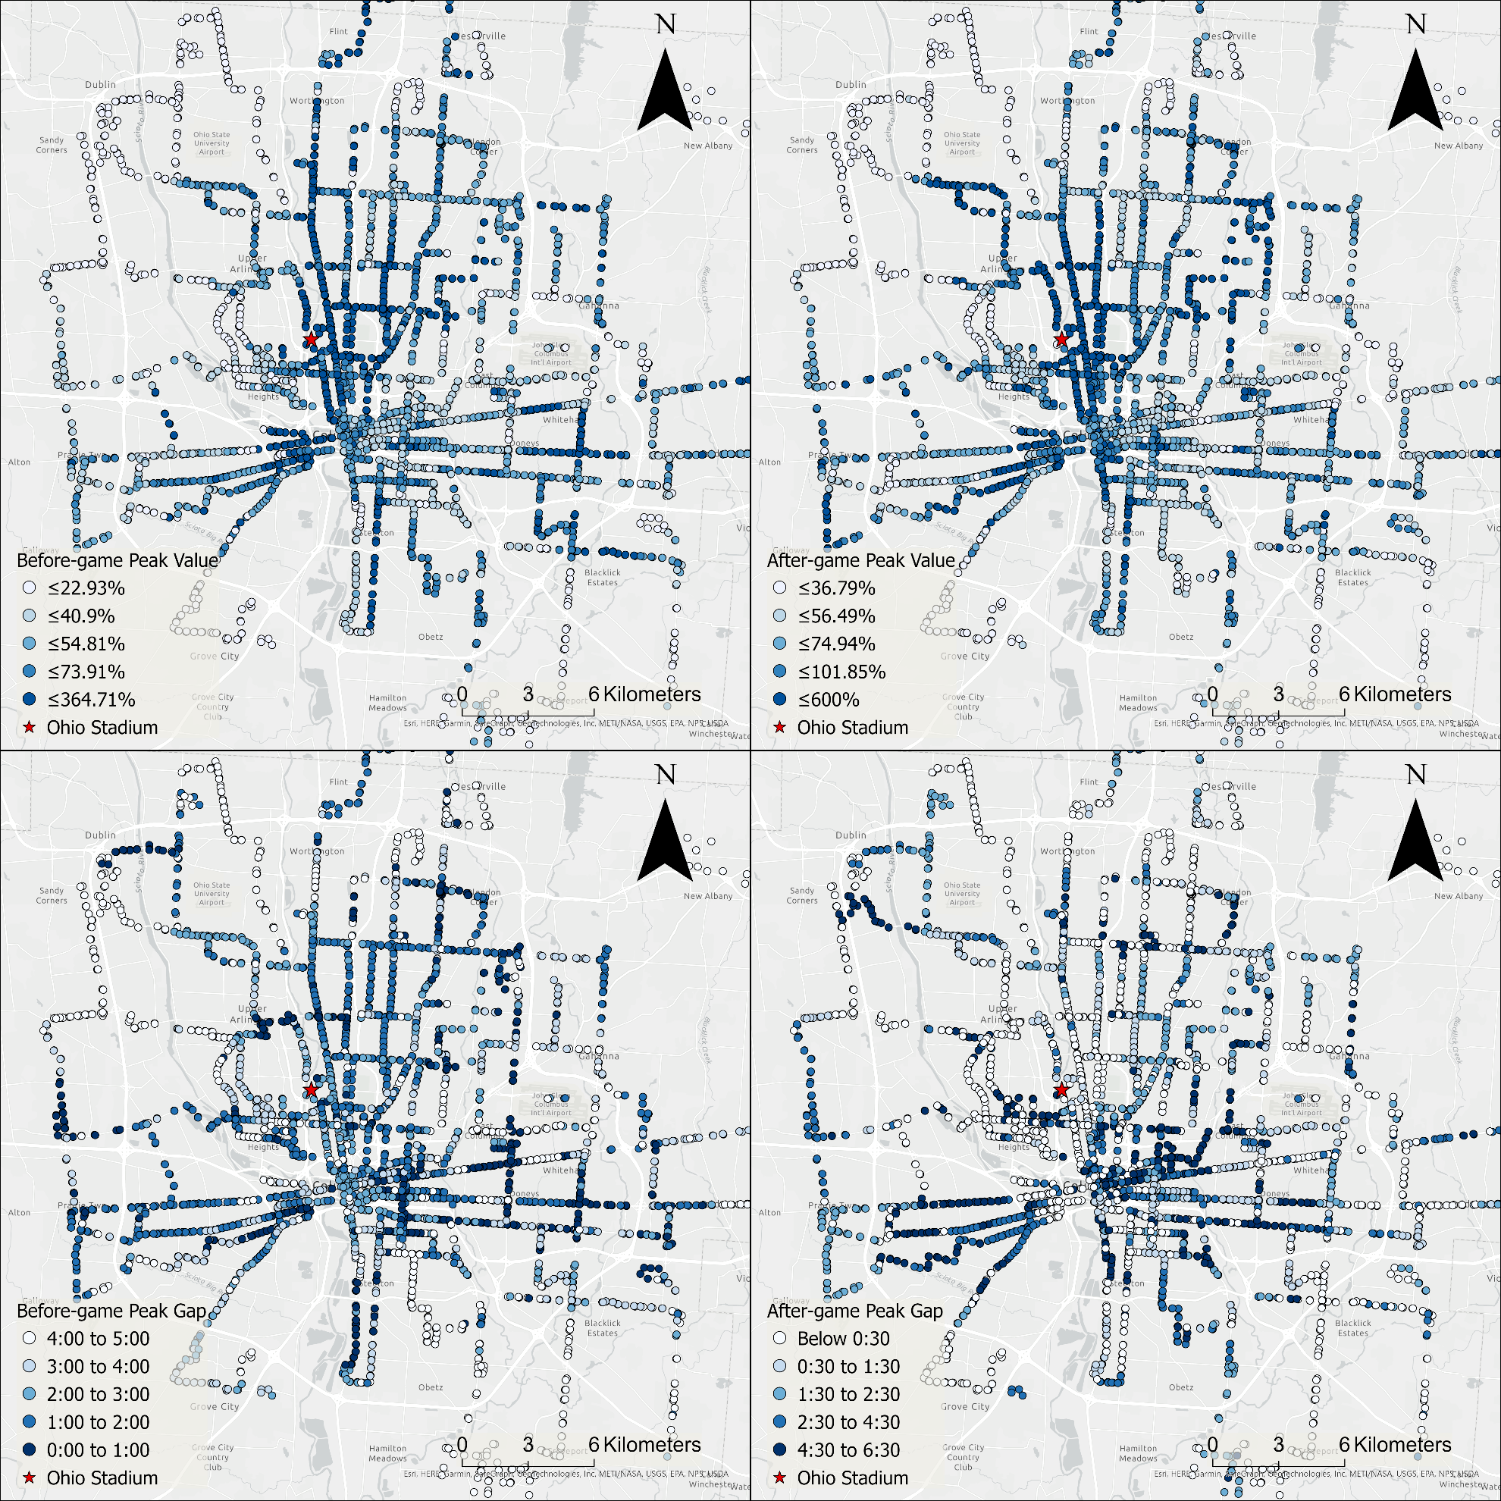
Football: Spatial Patterns
The highest value of unreliability before (up) and after (down) the game
Blue: more unreliable
White: more reliable
High cluster around Ohio Stadium
Strongly suggest the link between football and unexpectedly high unreliability

Slide 7



Thank you!
Contact
Luyu Liu: liu.6544@osu.edu
Adam Porr: aporr@morpc.org
Harvey Miller: miller.81@osu.edu

